Slide 1

Unit 3 Getting along with others
Integrated skills
Describing the qualities of a good friend

Slide 2

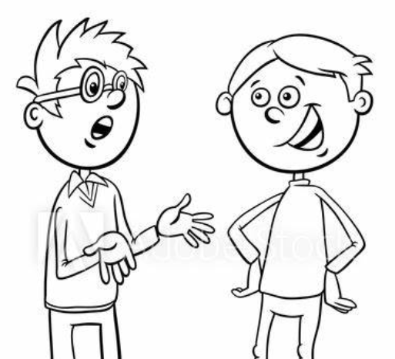
While-listening
Tim and Patrick are talking. Listen to the first half of the conversation. What are Tim's problems? Finish A1.

Slide 3
Listening
P36
A1
Tim is talking to his friend Patrick about his problems. Listen to the conversation and tick Tim's problems below.
√
1 Tim does not have enough time for his homework.
2 Tim is not sure what he wants to be in the future.
3 Tim has found his Maths homework quite difficult recentluy.
4 Tim is unhappy because he has no friends who can help him.
5 Tim does not understand some key points in his Chinese classes.
6 Tim is having difficulty with the reading task in his Chinese teacher has given him.
√
√
√

Slide 4
Listen to the conversation again and complete the notes.
A2
How Patrick helps Tim
Cheering Tim up by using positive language
Ask him not to (1)_______
Express his confidence in him.
Offering to (2)_________________ together with Tim
Find out how much time Tim should spend on (3)_____________
Find out how much time Tim should spend on Maths and Chinese
Planning to help Tim with his (4)___________
Meet after school and go over (5)__________________ together.
(6)_____________ to make sure Tim doesn't miss anything important
Do some reading together (7)_________________.
worry
make a timetable
his project
schoolwork
the challenging parts
Compare notes
at the weekend

Slide 5
Discussion
1. Is Patrick a good friend in your view? Why or why not?
2. What qualities are important to you in a friend?

Slide 6
Discussion
1. Is Patrick a good friend in your view? Why or why not?
Yes, because he is a caring person. He always uses positive language to encourage Tim and is willing to spend his spare time to help him. For me, that's what friends are for.

Slide 7
Discussion
2. What qualities are important to you in a friend?
loyal
real
sincere
positive
dependable
straightforward
generous
forgiving
protective
respectful

Slide 8
Reading
P37
B
Read Patrick's diary entry and try to understand his idea of what makes a good friend.
Fast reading
1. What's the topic of this diary entry?
2. What qualities form the basis of a friendship?

Slide 9

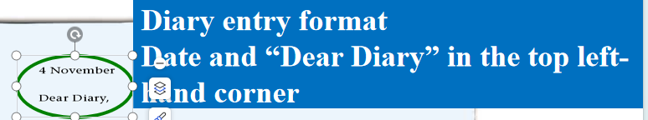
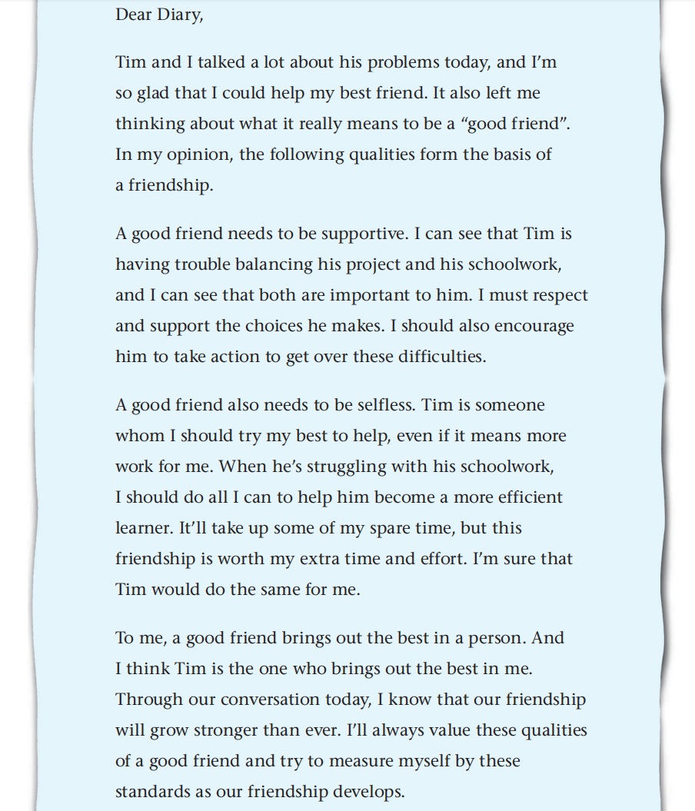
Reading for structure.
It fucnctions as an introduction to the whole diary.
What’s the function of the first paragraph?
The author's opinion
How are the rest of the three paragraphs organized?
The first sentence of each paragraph is used as a topic sentence, which is followed by facts and examples.

Slide 10
Reading
Further reading
1. What’s the function of Paragraph 1?
2. How is each of the following paragraphs developed?
3. What are the characters of a diary entry in terms of text type, format and language?

Slide 11
Reading for structure.
It fucnctions as an introduction to the whole diary.
What’s the function of the first paragraph?
The author's opinion
How are the rest of the three paragraphs organized?
The first sentence of each paragraph is used as a topic sentence, which is followed by facts and examples.

Slide 12
Para. 1: Introduce by offering a personal experience
Structure
Para. 2
Be supportive
Para. 3
Be selfless
Para. 4
Be able to bring out the best in a person
Support the opinion by giving facts and examples

Slide 13
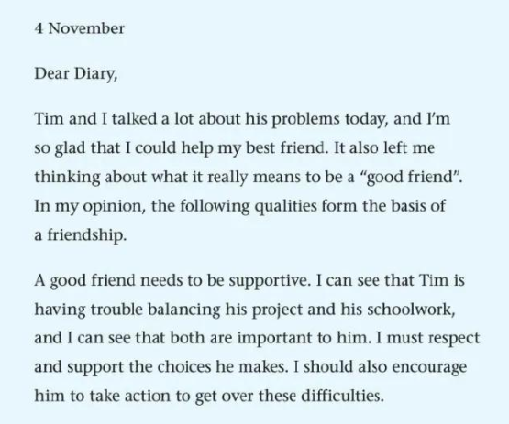
构成......的基础
giving help,
encouragement or sympathy to sb.
adj.支持的
“做某事的过程中遇到了麻烦”
克服

Slide 14
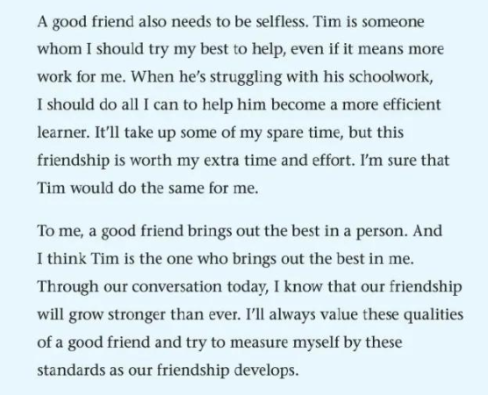
adj.无私的
selfish adj.自私的
selfishness n.自私自利
尽我所能做某事
“占用一些我的空闲时间”
take up
激发某人最好的一面；最佳的潜能
占用（时间，空间等）
开始从事；
接受（挑战，任务等）
measure oneself
要求某人自己

Slide 15
Further reading
What are the characters of a diary entry in terms of text type, format and language?
A diary entry is a record of a person's experience, thoughts, feelings or plans. As a personal form of writing, it is generally not meant to be read by anyone else.
You can write the date in the top-left hand corner of the page and begin with “Dear Diary”.
Try to use informal English, as if you were talking to a close friend. The first person “I” is often used in a diary entry.

Slide 16

Find and share
In groups, circle some useful expressions that describe friendship and qualities of a friend. You can also find more expressions by referring to the dictionary. Then please share them within your group and with other groups.

Slide 17
Find and share
In my opinion, the following qualities form the basis of a friendship.
A good friend needs to be supportive.
To me, a good friend brings out the best in a person.
It’ll take up some of my spare time, but this friendship is worth my extra time and effort. I’m sure that Tim would do the same for me.
I’ll always value these qualities of a good friend and try to measure myself by these standards as our friendship develops.
True friendship is like sound health, the value of which is seldom known until it is lost.
A friend in need is a friend indeed.
A friend is a second self.
Your friend is the man who knows all about you and still likes you.
A friend without fault will never be found.
Fire is the test of gold, adversity of friendship.
Friendship is one soul in two bodies.

Slide 18
Task
Write a paragragh about what makes a good friend
首先，在日记开头讲述一个与朋友相处的具体事例，引出对“什么造就好朋友”的思考。
然后，详细阐述好朋友应具备的品质，如忠诚、善解人意、有共同兴趣等，并结合事例进行说明。引用相关的名言，如“A friend in need is a friend indeed.” 来增强观点的说服力。
接着，描述这些品质如何在友谊中发挥积极作用。
最后，总结表达对真正友谊的珍惜和期待。
Para. 1: Introduce by offering a personal experience
Para. 4
Be able to bring out the best in a person
Para. 2
Be supportive
Para. 3
Be selfless
Structure
Support the opinion by giving facts and examples

Slide 19
Sample
Dear Diary
Today, something happened that made me think deeply about what makes a good friend. I was having a really bad day at work, filled with stress and mistakes. When I called my friend, Anna, she immediately dropped everything to come and be with me.

Slide 20
This made me realize that a good friend is someone who is loyal. They stand by your side no matter what. Just like the saying, "A true friend is one who overlooks your failures and tolerates your successes." Anna never judges me for my flaws.
A good friend is also understanding. They can sense your mood and offer comfort without you even having to explain. We share many common interests, which makes our bond stronger.

Slide 21
True friendship comes when the silence between two people is comfortable. With a good friend, you don't have to constantly talk to feel connected.
I'm truly grateful for having such a wonderful friend like Anna and cherish our friendship more than ever.

Slide 22
Writing
Informal English
Personal: uses the first person “I”
Emotional: allows for the display of true emotions
Using contractions and abbreviations
Simple: uses shorter or even incomplete sentences
Colloquial: uses informal words and slangs
withdraw
→
take away
furnish
→
supply

Slide 23
Useful Expressions
“stand by your side” 支持你；
“cherish our friendship” 珍惜我们的友谊
“sense your mood” 感知你的情绪
“common interests” 共同兴趣
“overlooks your failures and tolerates your successes”
忽略你的失败，包容你的成功

Slide 24
Useful Expressions
"His understanding of my pain and his unwavering support were the pillars that kept me going."
（他对我痛苦的理解和他坚定不移的支持是让我坚持下去的支柱。）
"A friend in need is a friend indeed." （患难见真情。）
“Friendship is a vital aspect of our lives” （友谊是我们生活中至关重要的一个方面）
“In my opinion, mutual understanding and support are far more important in a friendship than shared interests.” （在我看来，在一段友谊中，相互理解和支持远比共同兴趣重要得多。）
“Conversely, friendships based merely on shared interests might fade when those interests change or wane.” （相反，仅仅基于共同兴趣的友谊可能会在这些兴趣改变或减弱时褪色。）
“In conclusion, while shared interests can bring people together initially, it is the mutual understanding and support that sustain a true and lasting friendship.” （总之，虽然共同兴趣最初可以将人们聚集在一起，但正是相互理解和支持维持着一段真正持久的友谊。）

Slide 25
Key Expressions
1. leave me thinking
2. form the basis of a friendship
3. have trouble balancing ... and ...
4. take action
5. get over these difficulties
6. take up some spare time
7. bring out the best in a person
8. measure myself by these standards
使我在思考
形成友谊的基础
在平衡...之间有困难
采取行动
克服这些困难
占据一些闲暇时间
激发个人最好的一面
以这些标准审视自己

Slide 26
Homework
Write a diary entry about what makes a good friend. Use the expressions you get from part C and list the qualities you value in a friend.

